Slide 1

Welcome And Introductions
Department of Computer Science
Subject Code: COS1501
Theoretical Computer Science
Primary Lecturer:
Mr. Thapelo Sindane
Dr. Petra Le Roux

Slide 2
i. Table of Content
Introductions
House Rules
Some Motivation
Getting Started with COS1501

Slide 3
1. About Lecture
PhD Student
  University of Pretoria, Data Science For Social Impact Research Lab
  Major: Natural Language Processing and Computer Vision
Lecture
  University of South Africa
  Currently teaching COS1501
Volunteer
  Deep Learning Indabax, South Africa

Slide 4
2a. House Rules
Let us be respectful of one another
  Exchange criticism with respect
  Lets have controlled engagements – act professionally
Do your due diligence
  Please do your work and make sure you have exhausted all options before approaching the lecture
  The class has about 2000+ students. So individual attention will be granted where essential.

Slide 5
2b. House Rules
Procrastinators
  No late submission for assignments, test, or exams will be marked.
  Emailed submission will be ignored – automatic zero.
Helping others, and collaboration
  engage with lecture, and fellow student to reinforce your knowledge
  This will be rewarded.

Slide 6
2c. House Rules
Consultations
  Given the large class, consultations will be done in class – 30 minutes schedules before class ends.
  It is the responsibility of the students to alert the lecture if this is needed in class, to be scheduled for the next coming class.
Read your study guide

Slide 7
2d. House Rules
Reporting
  If you have challenges either with me or others, lets sit and talk through them.
  If this is not working out for you, look for proper communications channels to escalate the matter higher in the official study guide.
  Hopefully it will not get to this part.

Slide 8
Motivation
Aristotle
  Excellence is not an act but a habit. Therefore, you are what you repeatedly do.
  I will do my best to encourage, inspire, support and motivate. But it is up to you to excel in this course
  Study, study, and study again. If you feel like you have studied enough, study once more. And Repeat
  everything worthwhile takes effort

Slide 9
Discrete mathematics
Mathematics can simply be viewed as a tool to solve complex problems
  Logic
  Deductions
  And definitions
Discrete mathematics is suitable when finite-driven solutions and continuous mathematics are not ideal.

Slide 10
Main components of Discrete mathematics
Set theory,
Relations and functions
Vector and matrix manipulations
Mathematical proofs
Propositional logic.

Slide 11
Main components of Discrete mathematics
Set theory,
Relations and functions
Vector and matrix manipulations
Mathematical proofs
Propositional logic.

Slide 12
Outcomes and Learning Objectives
Should be able to critically apply the fundamental knowledge and skills of discrete mathematics
Think in an abstract way to construct logical arguments, using a variety of mathematical tools
Construct proofs in a clear and concise way using mathematical reasoning techniques.

Slide 13
Outcomes and Learning Objectives …
Demonstrate knowledge and understanding of the definitions, laws and operations of set theory
Synthesise and critically analyse relations, functions and binary sets that are represented as sets containing ordered pairs
Perform operations on vectors and matrices

Slide 14
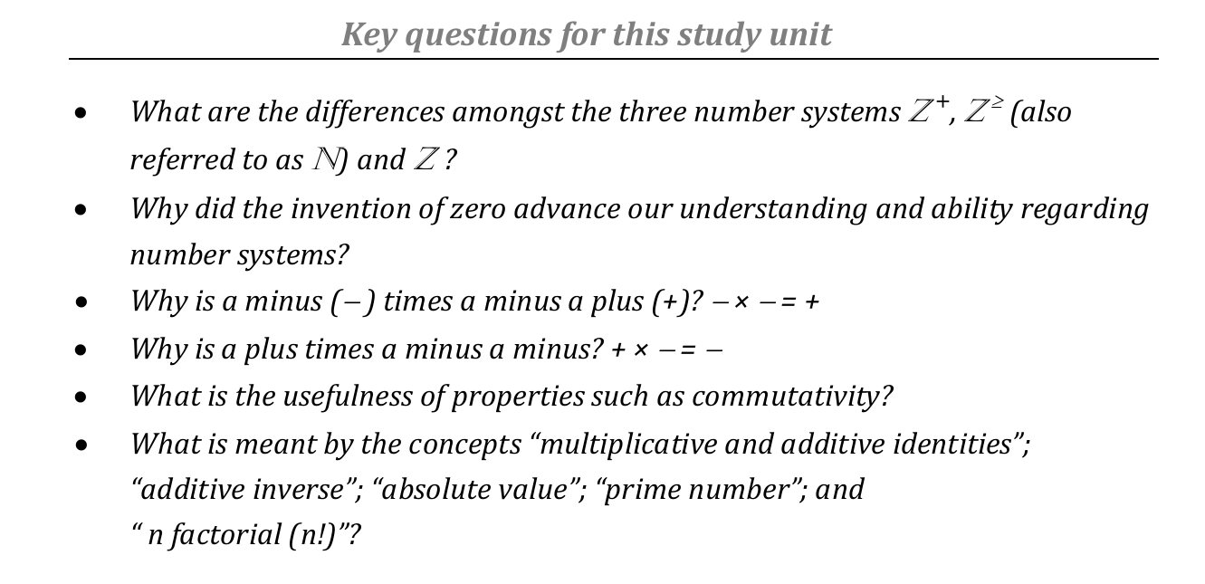
The development of the Number system

Slide 15
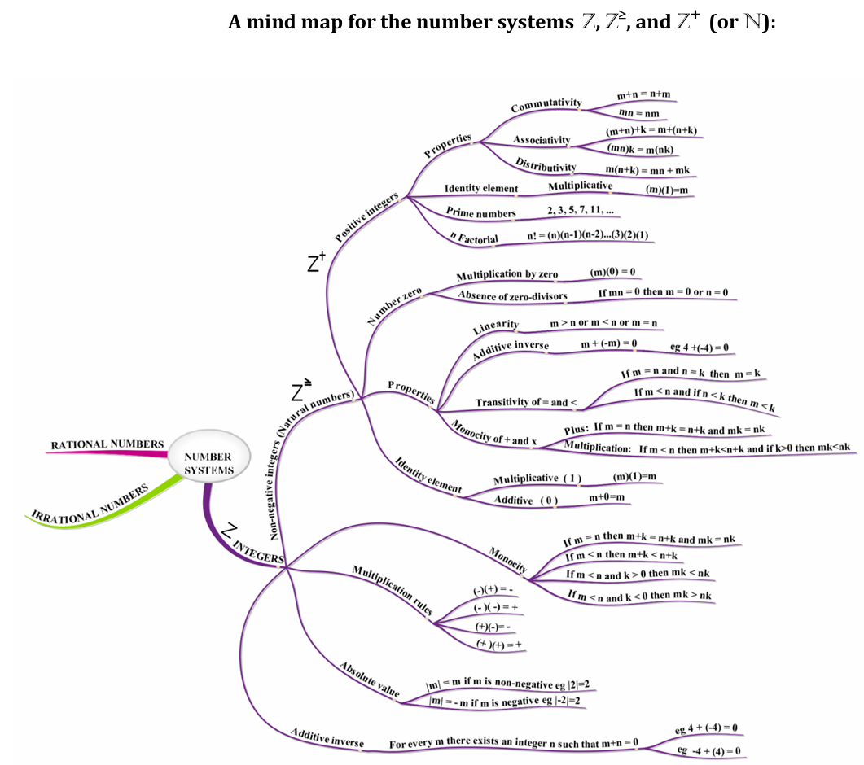

Slide 16

These are a set of all positive number E.g 1, 2, 3, 4, 5, ... And so on.
We can mathematically indicate the notion of a set by writing curly brackets. E.g
  Z⁺ = {1, 2, 3, …}
  The elements of the set are also known as members of the set
  They are separated by commas
These are the numbers we would use to count sheep, for example. Historically, before discovering numbers such as zero and the negative integers, people worked with these numbers.

Slide 17
The principles of commutate, associative, and distributive
We all know how to add and multiply positive integers.
There are rules that extend beyond this and govern how this should be done between 2 or more positive intergers

Slide 18
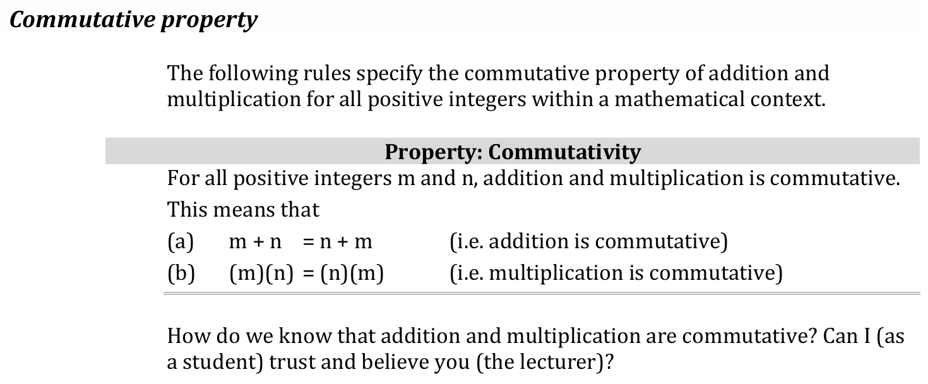
The principles of commutate, associative, and distributive

Slide 19
Example
Let m=6, and n=2 be numbers from a set of positive intergers. Proof that addition, and multiplication between m and n is commutative ?
To prove that m,n is commutative within the Positive integers space ➔ we need to show that m+n = n+m
L.H.S m+n = 6+2 = 8
R.H.S n+m = 2+ 6 =8 = L.H.S . Therefore addition is commutative. Do the same for multiplication.

Slide 20
Question
Lets jump a bit shall be
Does the commutative property for all integers m, and n in the set of all integers Z = { …, -2, -1, 0, 1, 2, …} ?

Slide 21
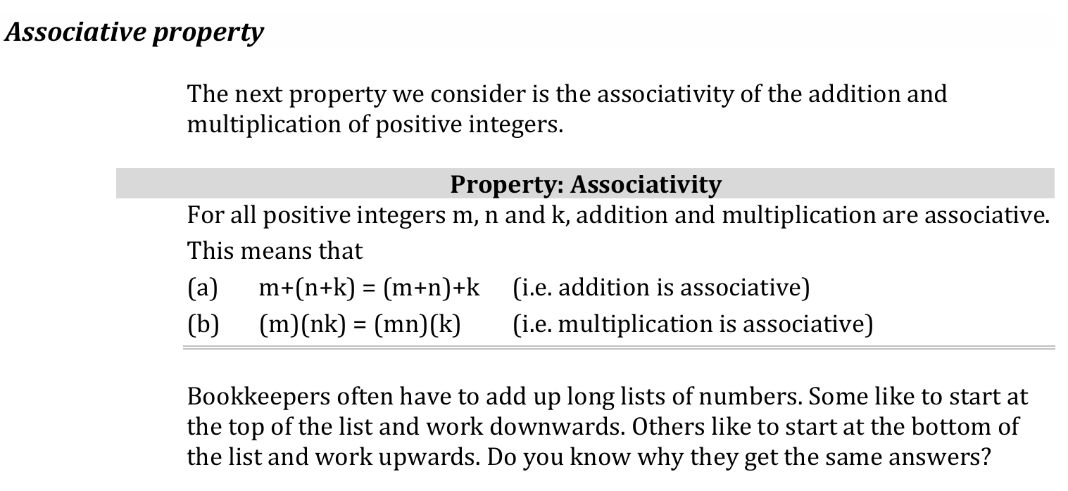
The principles of commutate, associative, and distributive

Slide 22
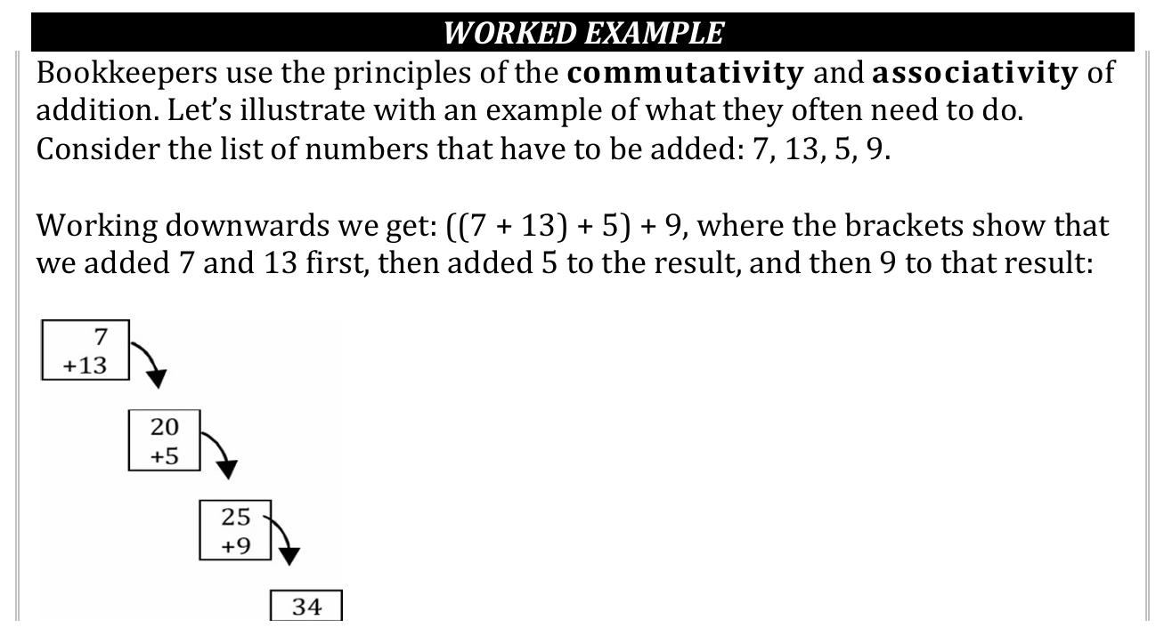
The principles of commutate, associative, and distributive

Slide 23
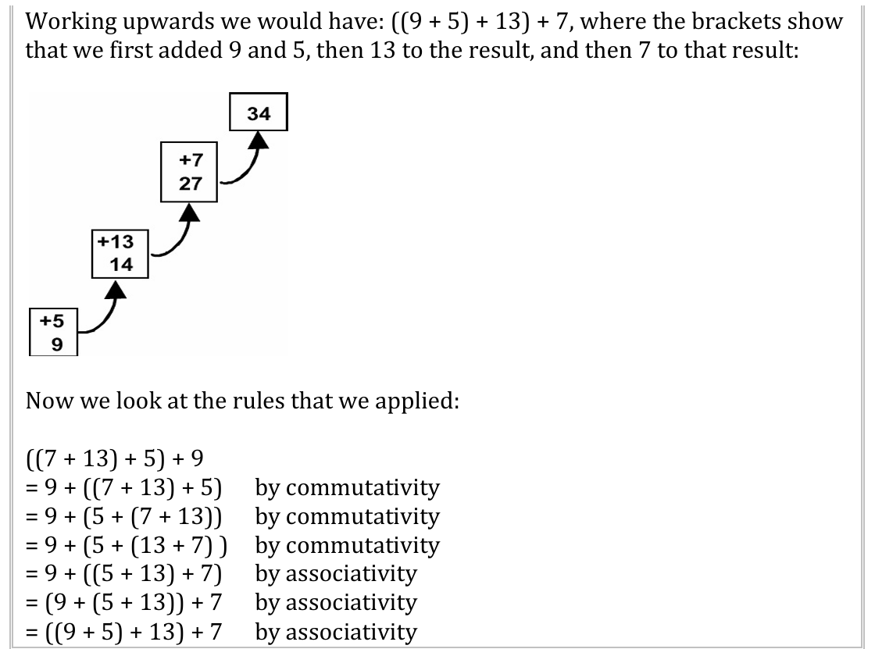
The principles of commutate, associative, and distributive

Slide 24
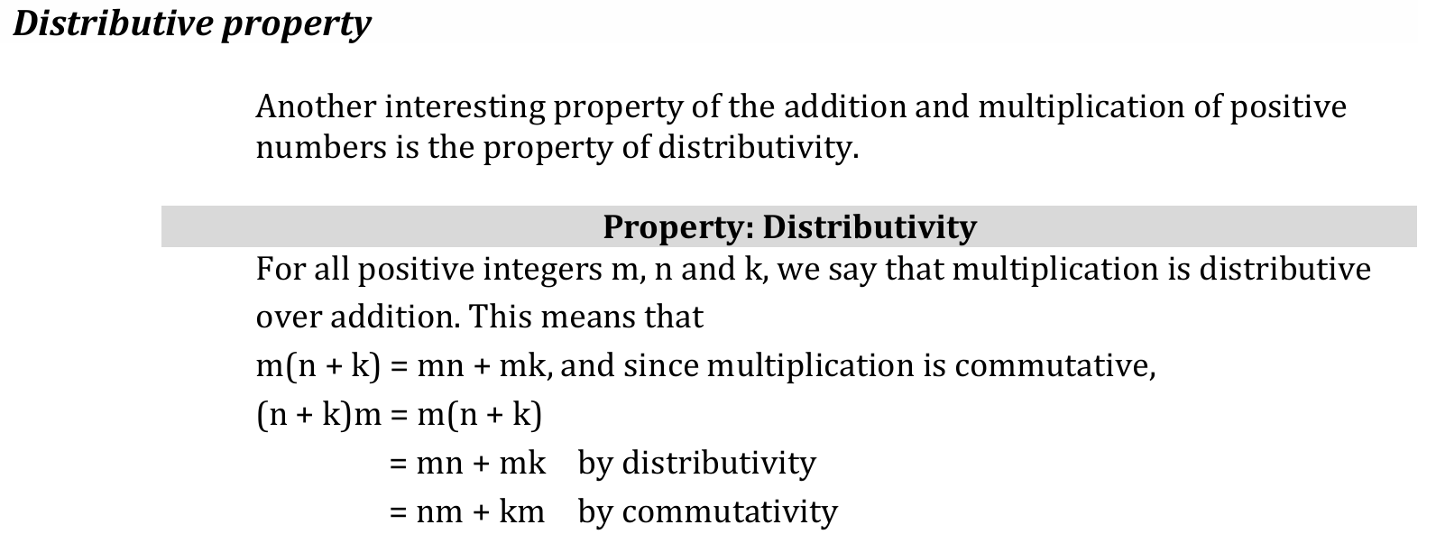
The principles of commutate, associative, and distributive

Slide 25
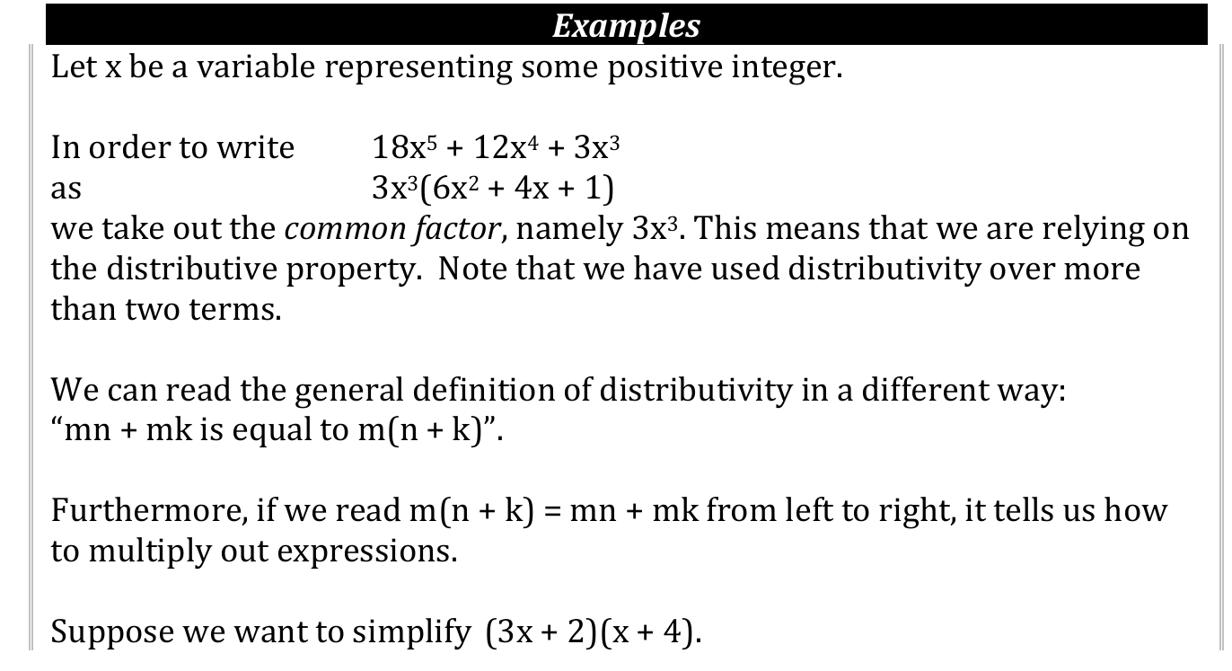
The principles of commutate, associative, and distributive

Slide 26
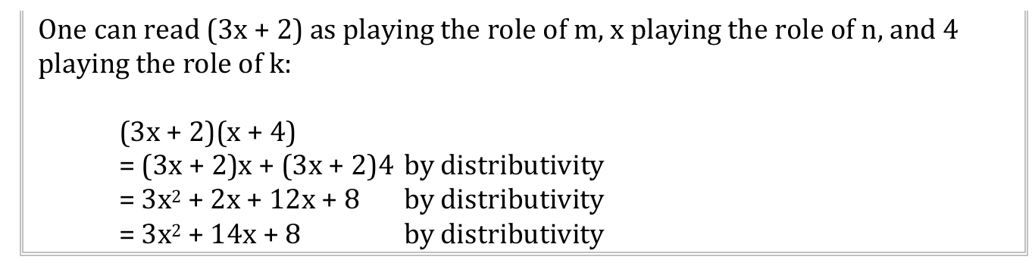
The principles of commutate, associative, and distributive

Slide 27
Question ?
Do you think that addition is distributive over multiplication, i.e. that m + (nk) = (m+n)(m+k)? Substitute a few values for m, n and k to see whether you get the same answer for the left-hand side and the right-hand side of the equation.

Slide 28
Additive and Multiplicative Identities
In Mathematics there exist unique numbers that when you multiply with or sum with the’’ ‘’other number’’, the results become the “other number”.

Slide 29
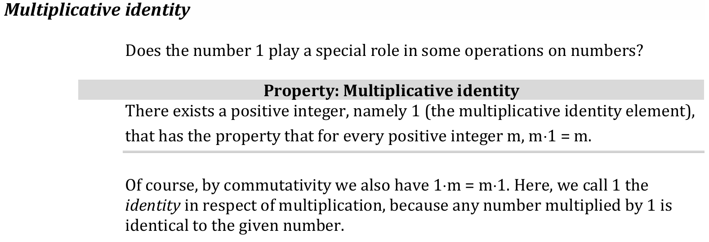
Multiplicative Identity

Slide 30
The set of all non-negative integers (natural numbers), namely the numbers 0, 1, 2, 3, 4, ... and so on
Written as Z≥ = {0, 1, 2, 3, … }
The only difference between Z≥ and Z⁺ is that Z≥ has as member the additional number zero.

Slide 31
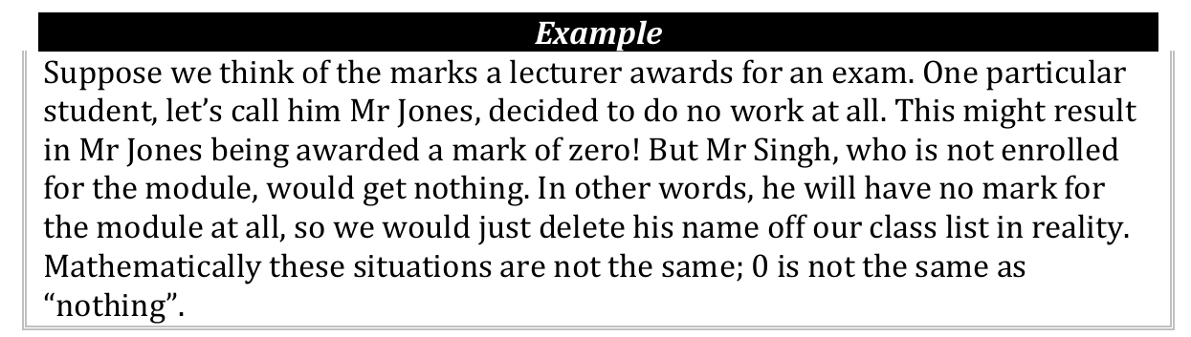
Well, why is zero Important
The difference between zero and nothing.

Slide 32
History on Zero
Discovered by the Hindus in the seventh or eighth century AD in India
Made the positional natation possible
  Position of a digit within a number is important

Slide 33
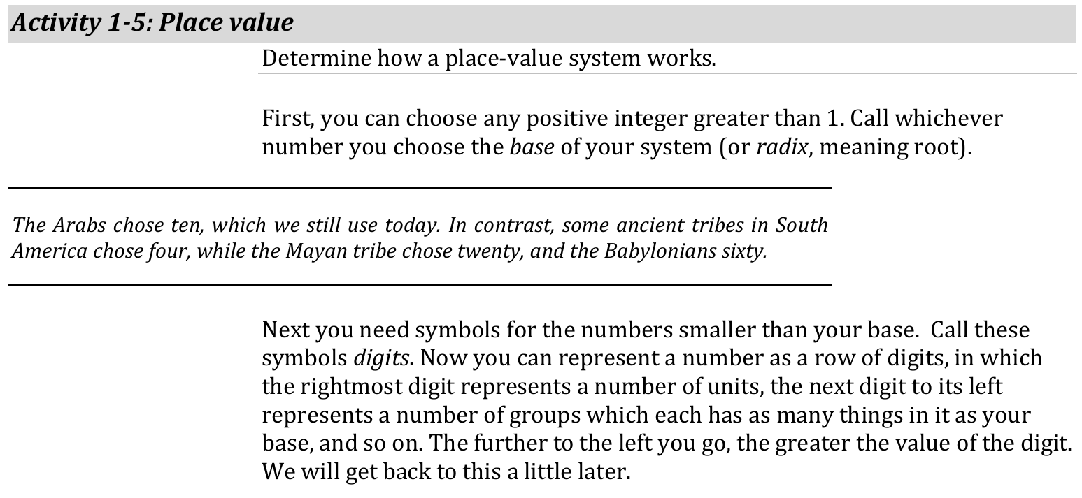
Birth of place-value system

Slide 34
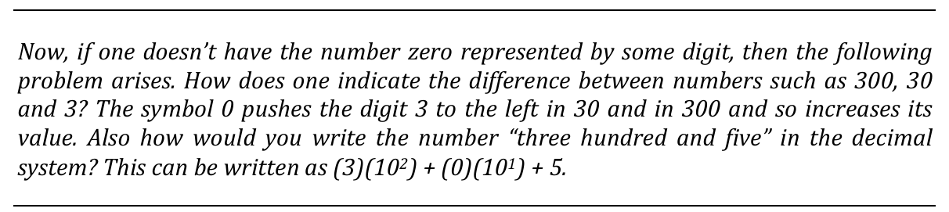
Examples
Let’s see how it works in the familiar decimal system (of which the base is 10)
We have as digits the familiar symbols 0, 1, 2, 3, 4, 5, 6, 7, 8 and 9.

Slide 35
Questions
How do we represent one hundred and thirteen in this number system?
How would you multiply (186)(10) in the decimal system?

Slide 36
Benefits of including 0 in the number system
Addition and multiplication are not made more difficult by the inclusion of 0.
These operations remain:
• commutative and
• associative;
• the distributive property is retained, and
• 1 is still the multiplicative identity.
However, we gain two important new properties.

Slide 37
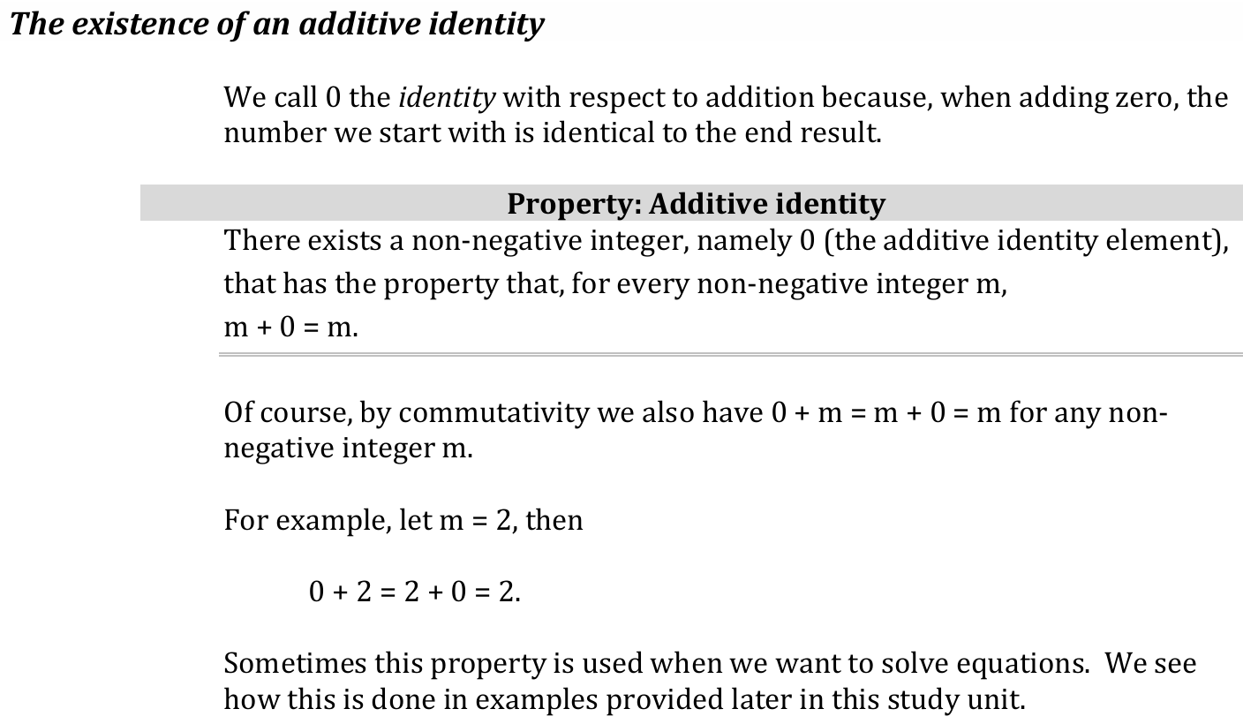
Additive Identity

Slide 38
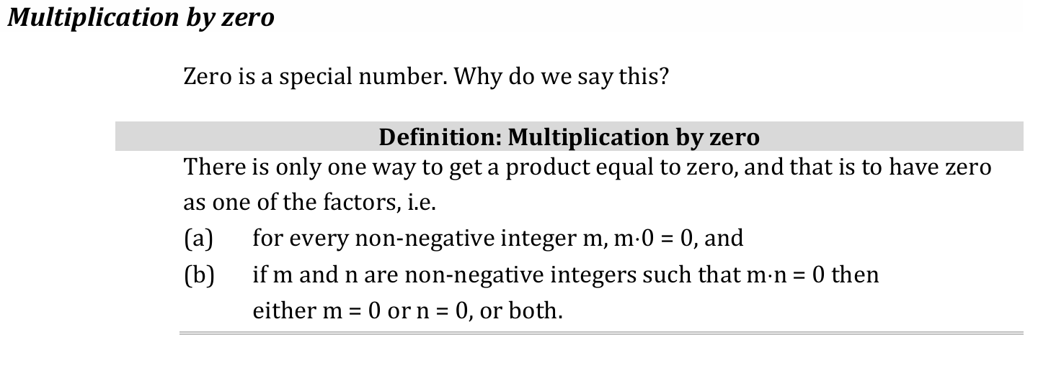
Multiplication by Zero

Slide 39
Multiplication by Zero

Slide 40
Why you where doing solve for x by equating to zero
x² + 2x + 1 = 0

Slide 41

The set of all integers in both directions (negative and non-negative), namely the numbers ... , −3, −2, −1, 0, 1, 2, … .
We can write Z = {... , −3, −2, −1, 0, 1, 2, …}.

Slide 42
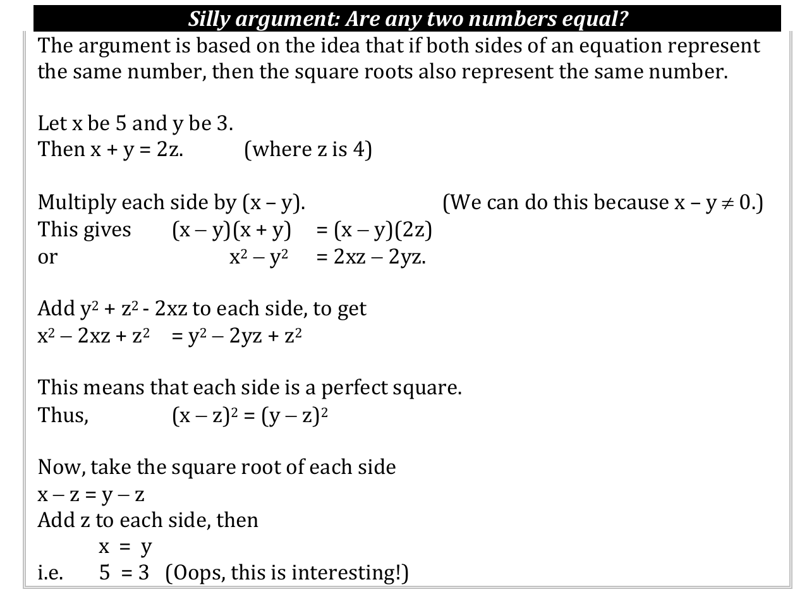

Slide 43
Importance of expanding the number system
Many uses were found for the expanded system of integers. Just think again of rating things according to a scale.
Think for instance of temperature measured in centigrade, with a mid-point indicating the temperature at which water freezes.
°C . . . .−50 . . . . 0 . . . . 50 . . . . 100
business might choose as mid-point its break-even point at which it has covered its expenses but not made any profit, and then choose increasing net profit as the positive direction and increasing net cost as the negative direction

Slide 44
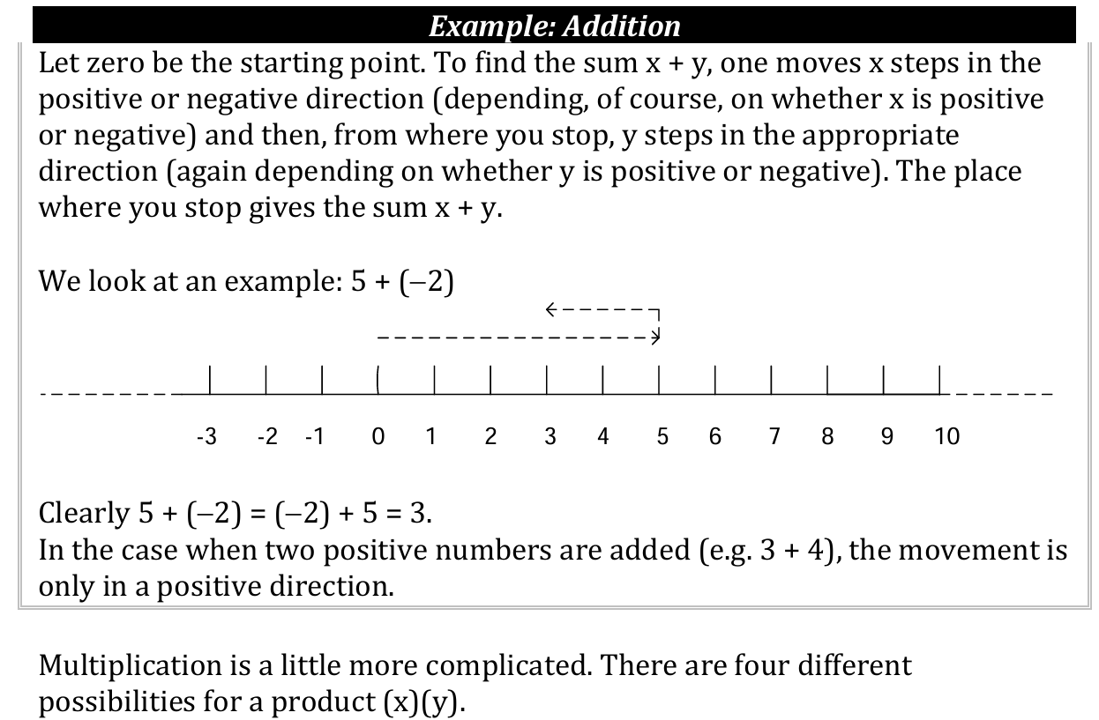
Addition visualized

Slide 45
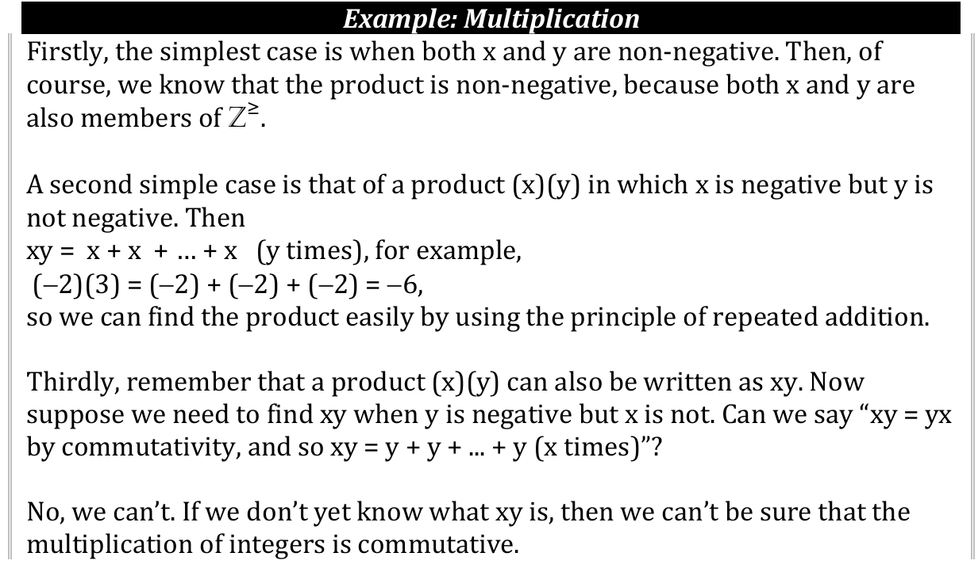
Multiplication

Slide 46
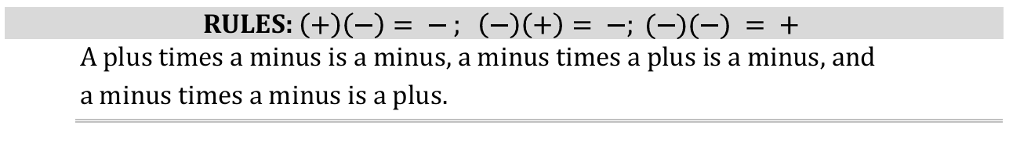
Foundation for Multiplication

Slide 47
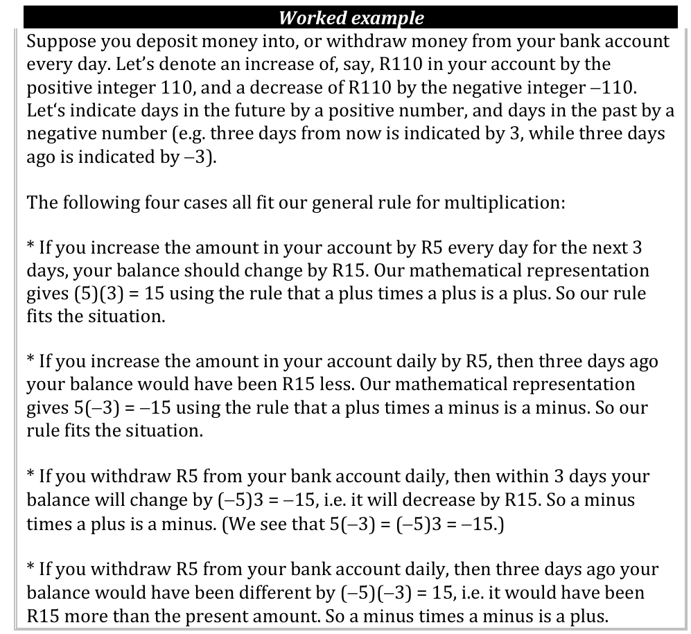
Concretise these

Slide 48
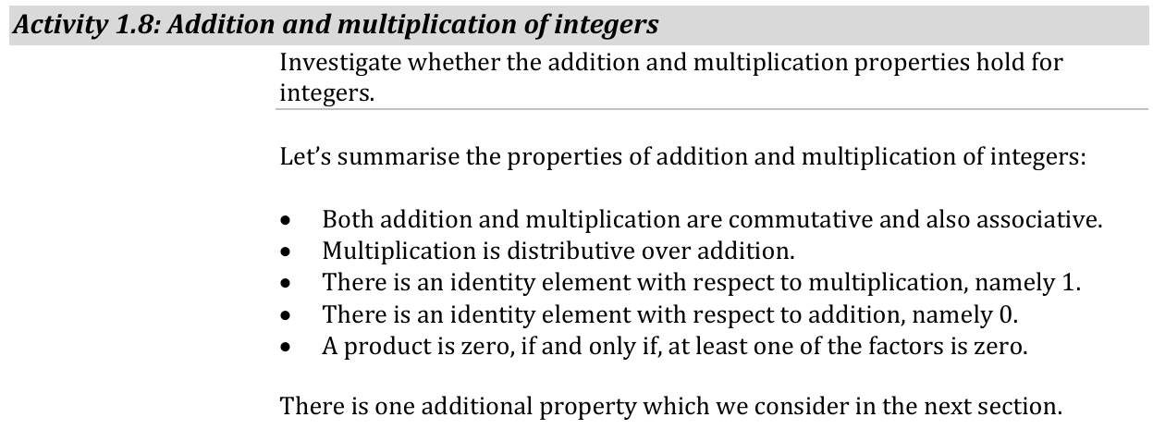
Summary

Slide 49
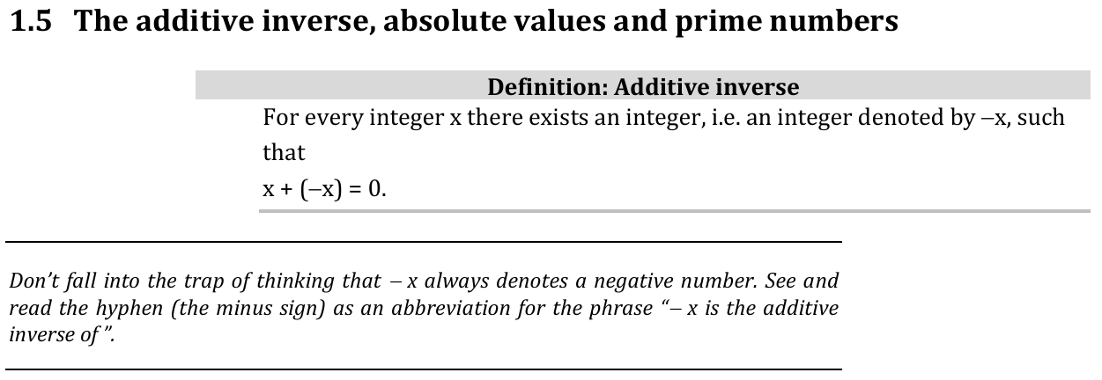
Additive Inverse

Slide 50
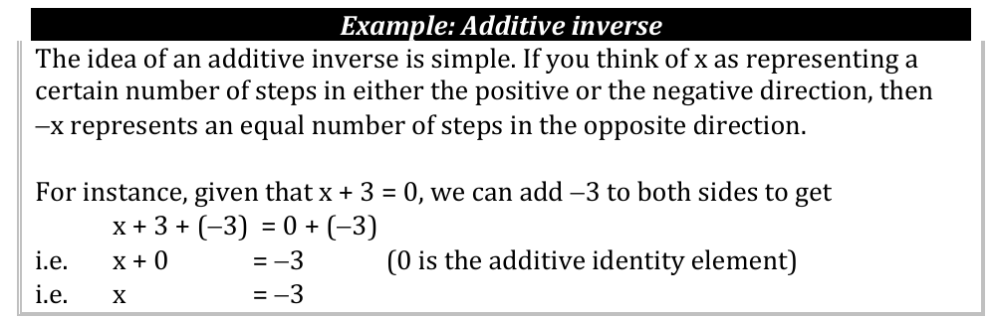
Additive Inverse

Slide 51
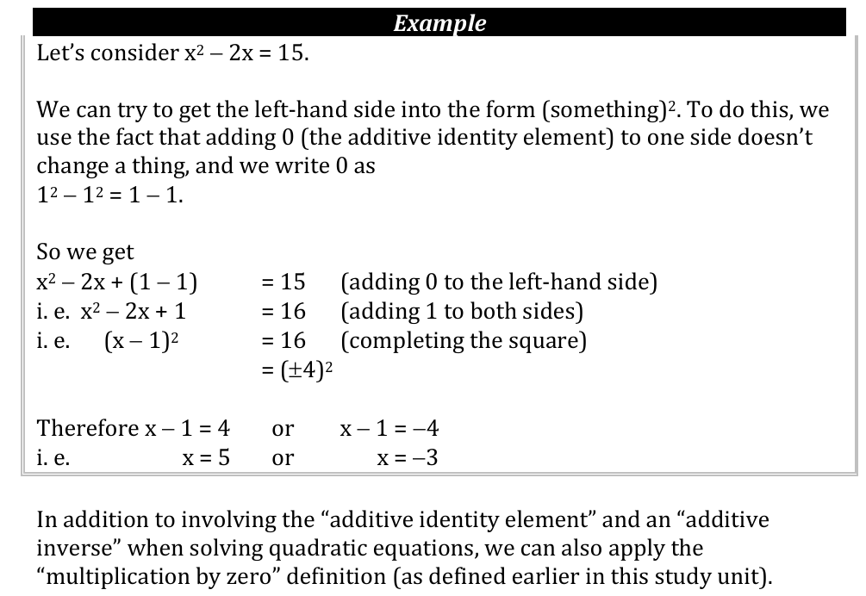
Examples

Slide 52
Examples
Solve for x² − 2x − 3 = 0.

Slide 53
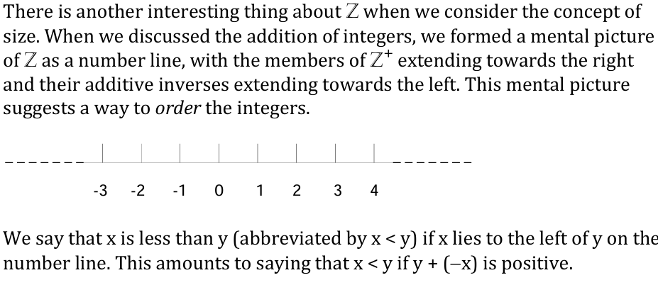
Notion of equality

Slide 54
Question
Draw a number line (as given above) to show your understanding of the concept −5 < 2.

Slide 55
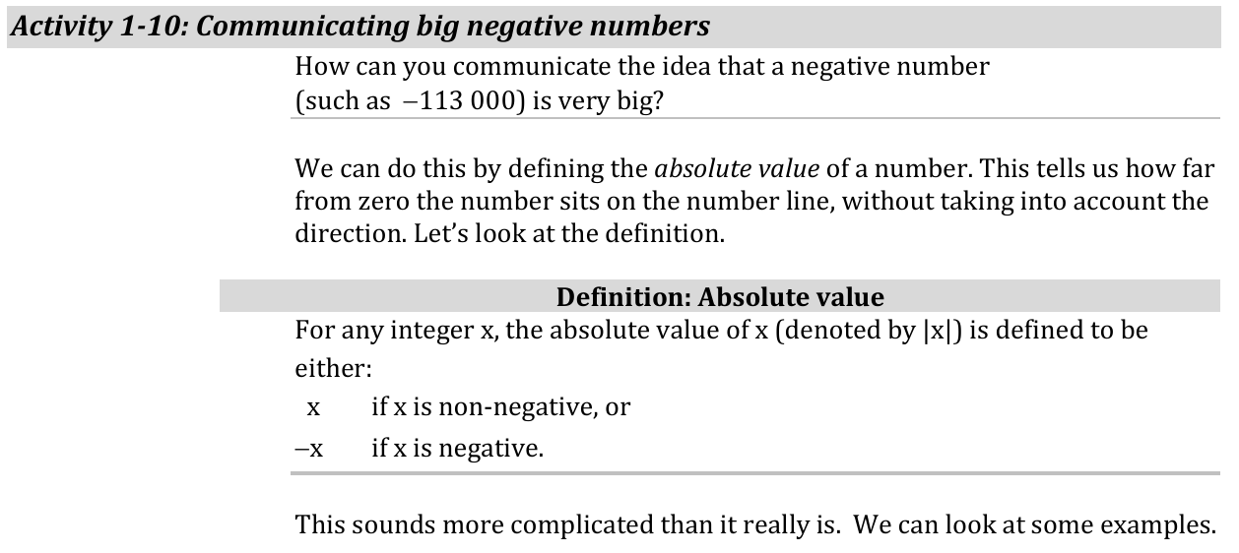
Absolute values

Slide 56
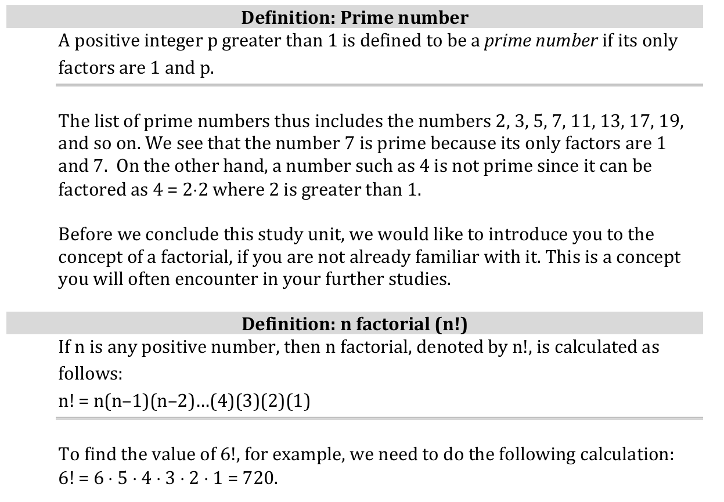
Prime and Factorial

Slide 57
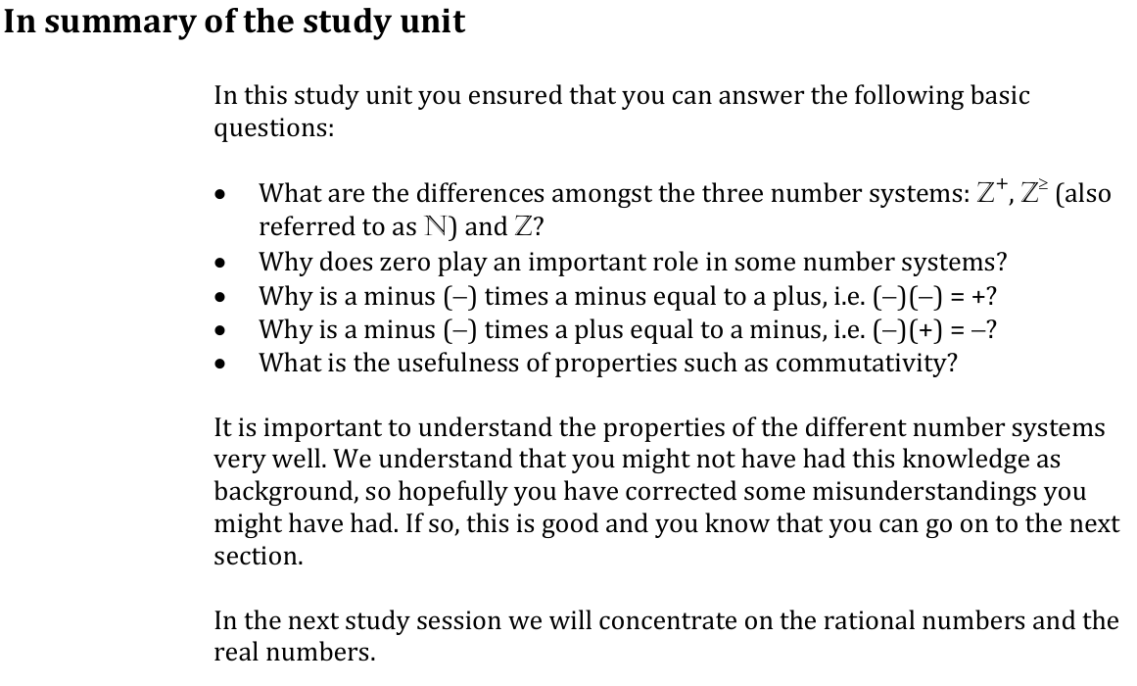
Summary study Unit

Slide 58
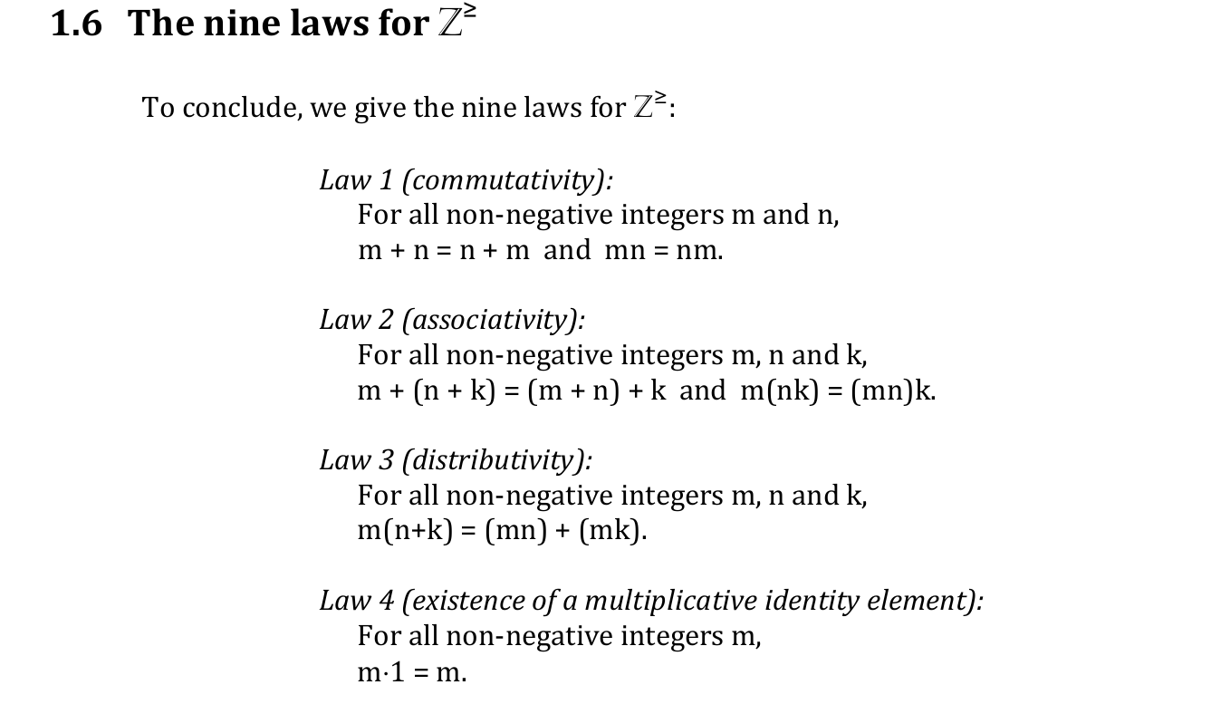
Laws

Slide 59
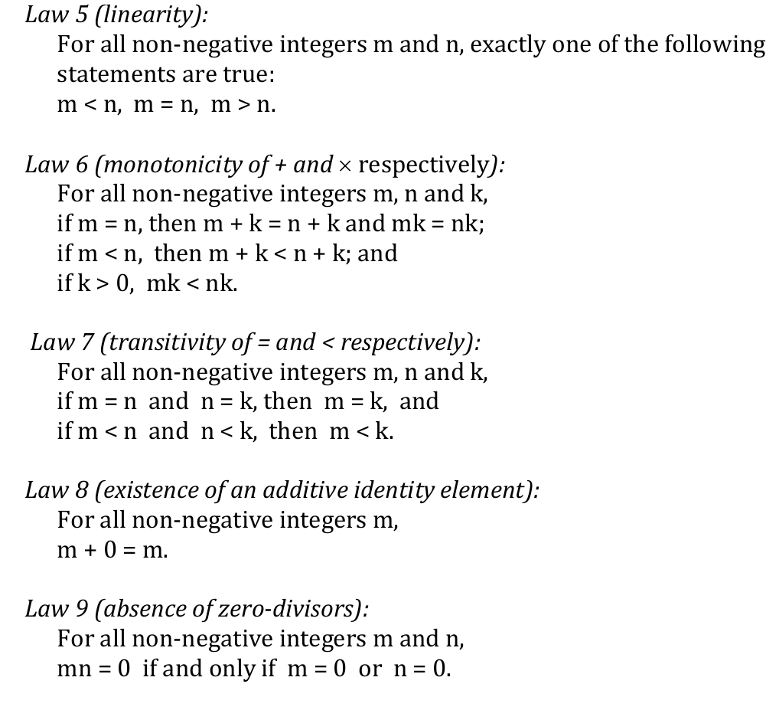
Laws

Slide 60
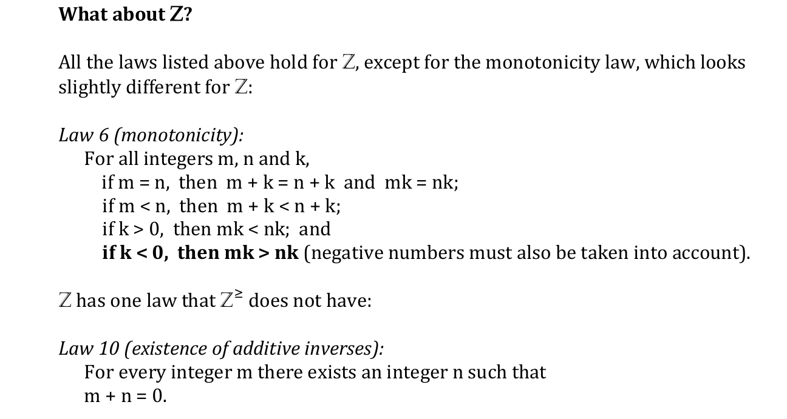
Laws

Slide 61
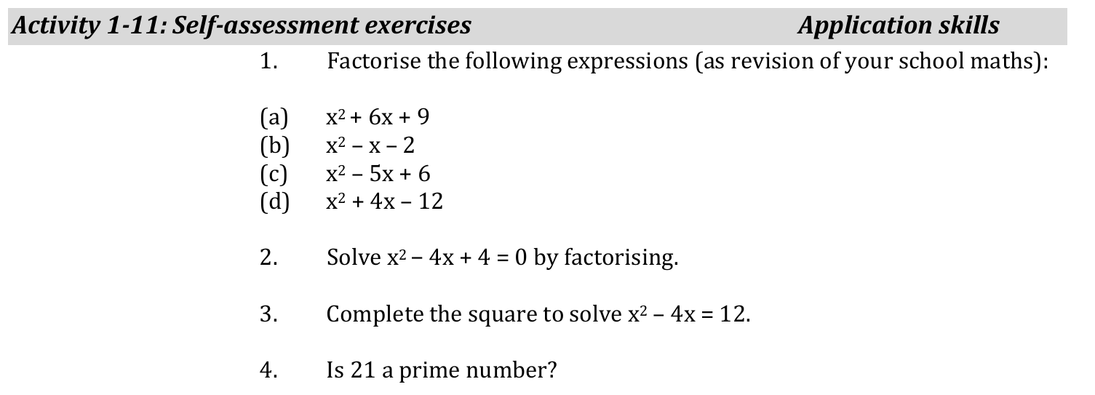
Self-assessment

